Slide 1
Memory Forensics
A Practical Approach to Investigate Data Leakage with Volatility 2

Slide 2
Memory and Memory Dump

Slide 3
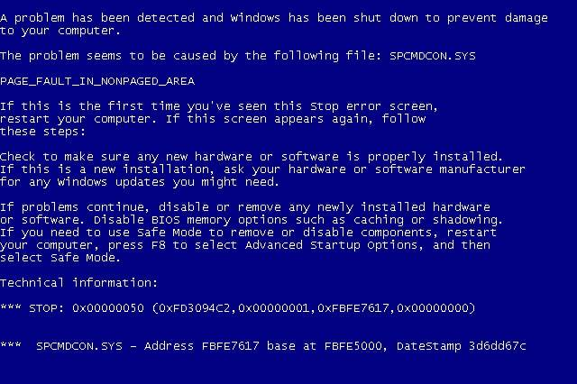

Memory Dump
A memory dump is a process
takes all information in RAM and writes it to a storage drive in case of an application or system crash
known as core dump, and blue screen of death (BSOD) in Windows-based computers
A memory dump is a binary file
A memory dump helps software developers and system administrators to diagnose, identify and resolve the problem that led to an application or system failure.

Slide 4
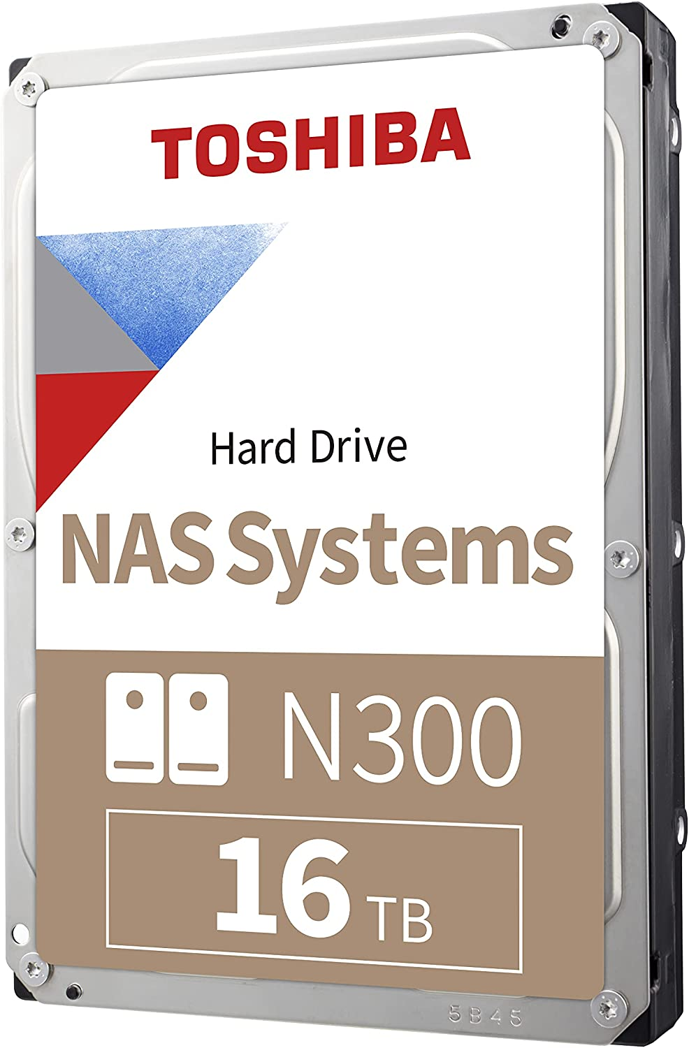
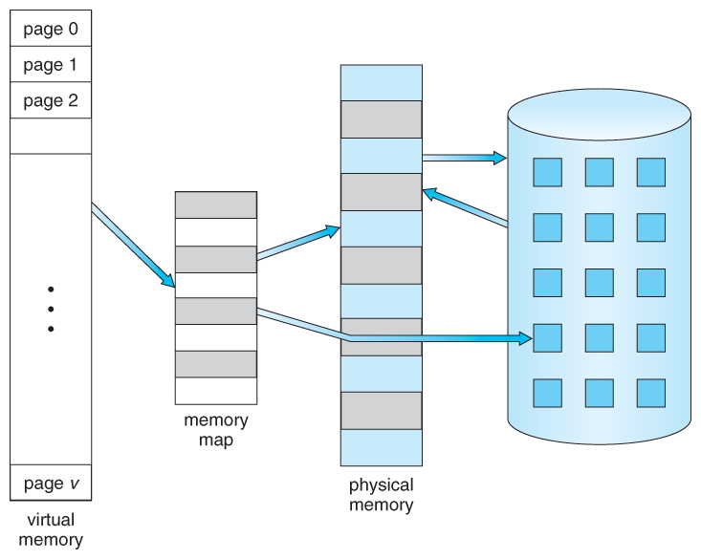
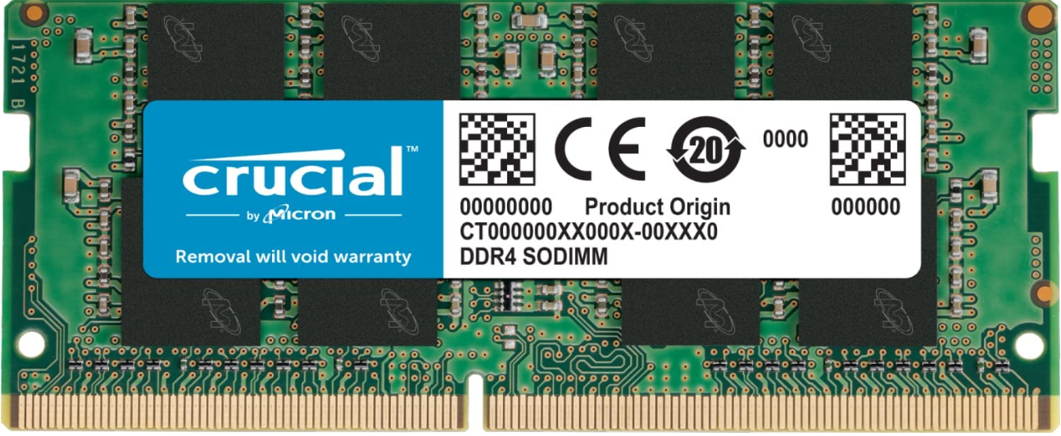
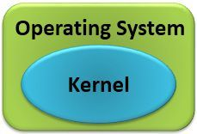

Memory, Virtual Memory, Disk
page is the smallest unit of data for memory management
Each process can use
4GB of virtual memory
Managed by
https://www.cs.uic.edu/~jbell/CourseNotes/OperatingSystems/9_VirtualMemory.html

Slide 5
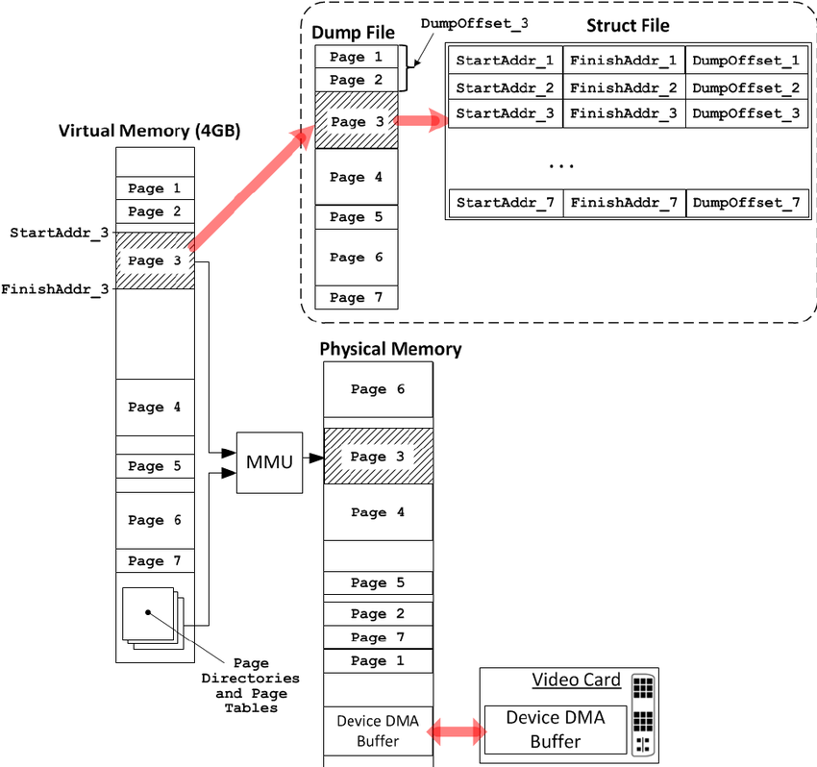
Memory dump for a process
Kernel Processor Control Region (KPCR)
is a data structure used by the Windows kernel to store information about each processor
From the KPCR structure, one then traverses intermediate structures to access interesting structures
such as the active process list
Each process dumped and stored in KPCR
https://www.researchgate.net/profile/Igor-Korkin-2/publication/263365115/figure/fig1/AS:296534018150400@1447710627176/Memory-dump-acquisition-process.png

Slide 6
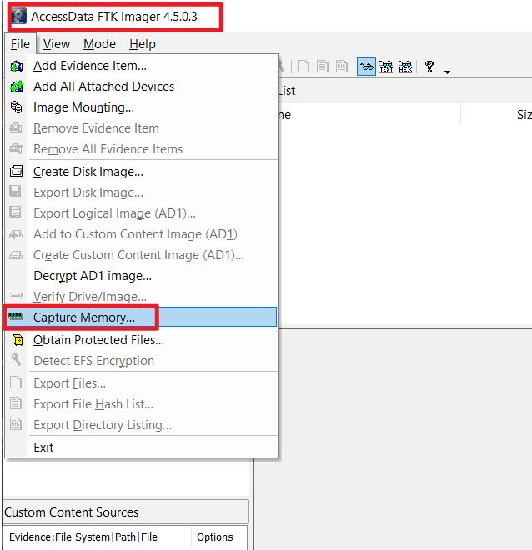
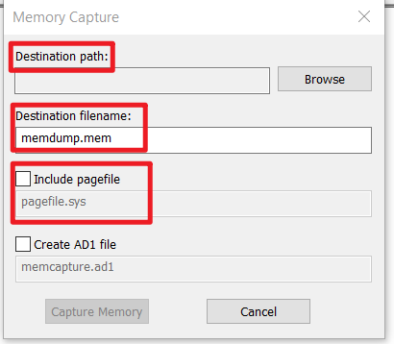

Dump memory
Pagefile.sys is a system file in Windows set aside for your computer’s Random Access Memory (RAM).
When your computer's RAM begins to run out of memory, it uses the pagefile to offload data it doesn't need, such as files and apps.

Slide 7
Volatility Framework - Volatile memory extraction utility framework
For the extraction of digital artifacts from volatile memory (RAM) samples (dumps).
offer visibility into the runtime state of the system
support Win, Linux, and iOS
Analyse raw dumps
memory dumps, crash dumps, virtual machine snapshots, VMware dumps (.vmem), Microsoft crash dumps, hibernation files, virtual box dumps
An open collection of tools (plugins)
Version 2 is implemented in Python [2.6-3.0)
under the GNU General Public License (run, study, share, and modify )
Provide a platform for further work in forensic research.

Slide 8
Pre-investigation
Volatility 2.X installation

Slide 9
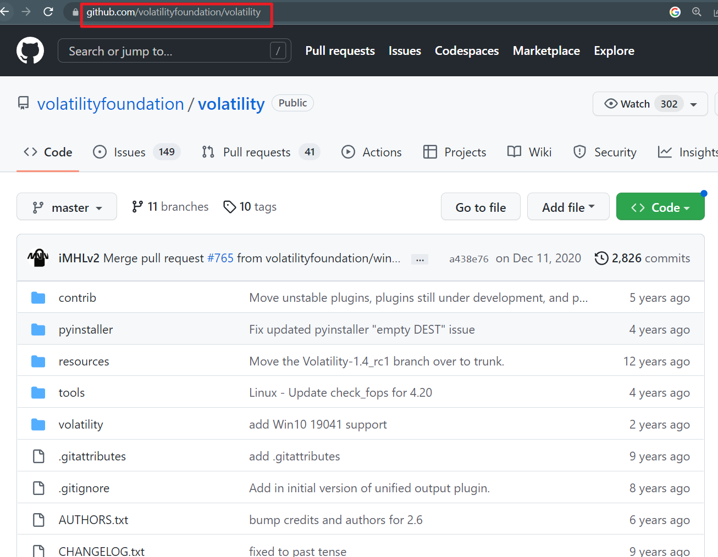

Slide 10
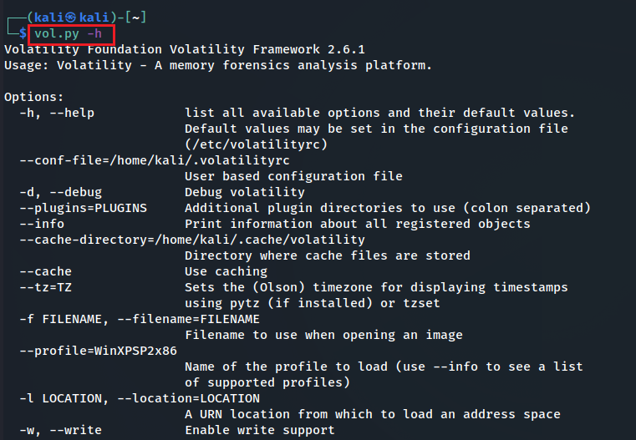
How to install Volatility 2?
If you have downloaded Kali from our GitHub, volatility has been pre-installed
You MUST use vol.py

Slide 11
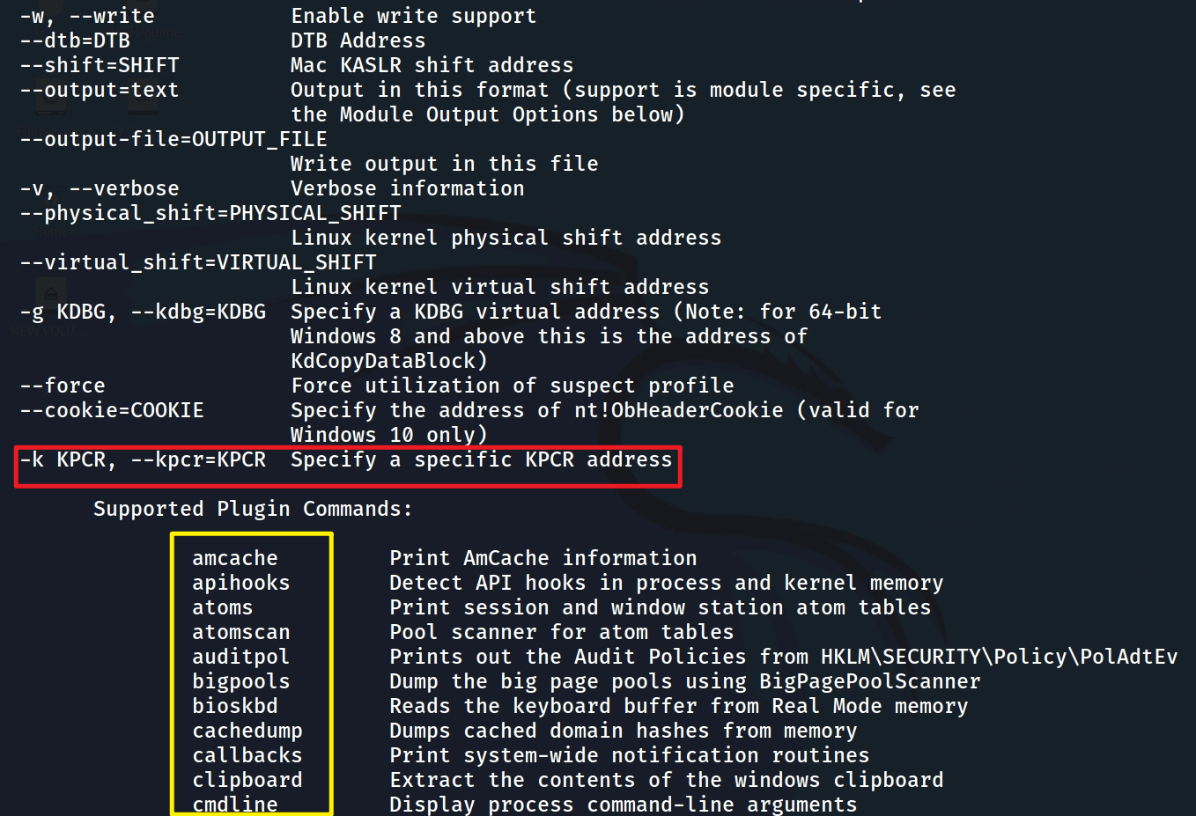
Kernel Processor Control Region

Slide 12

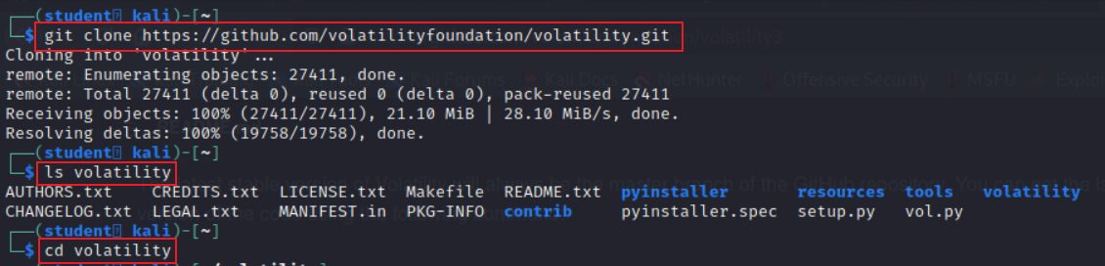
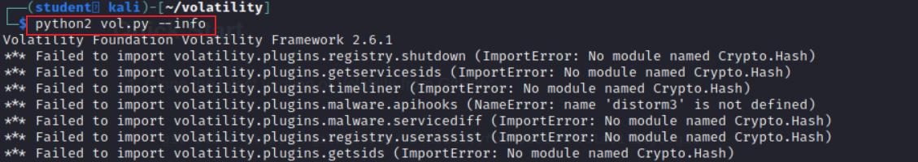
Manual install Volatility 2? (not recommend)
for all commands starting with volatility, you MUST replace them with python2 vol.py
for example, volatility -f memdumpWin7.mem imageinfo MUST changed to python2 vol.py -f memdumpWin7.mem
Notes:
git clone https://github.com/volatilityfoundation/volatility.git
cd volatility

Slide 13

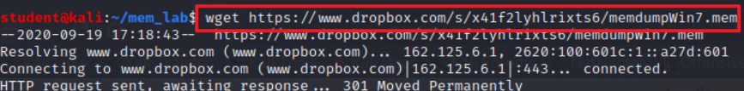
Where to download the memory image for investigations?
Download memory dump
Verify downloaded file
Notes:
wget https://www.dropbox.com/s/x41f2lyhlrixts6/memdumpWin7.mem

Slide 14
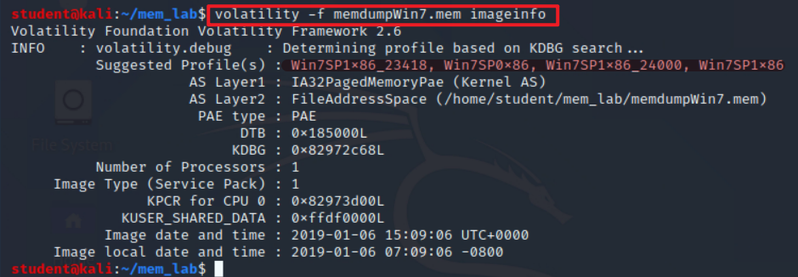
How to identify the image profile?
Use vol.py (NOT volatility) if you use the customized Kali from GitHub
Notes:
volatility -f memdumpWin7.mem imageinfo

Slide 15
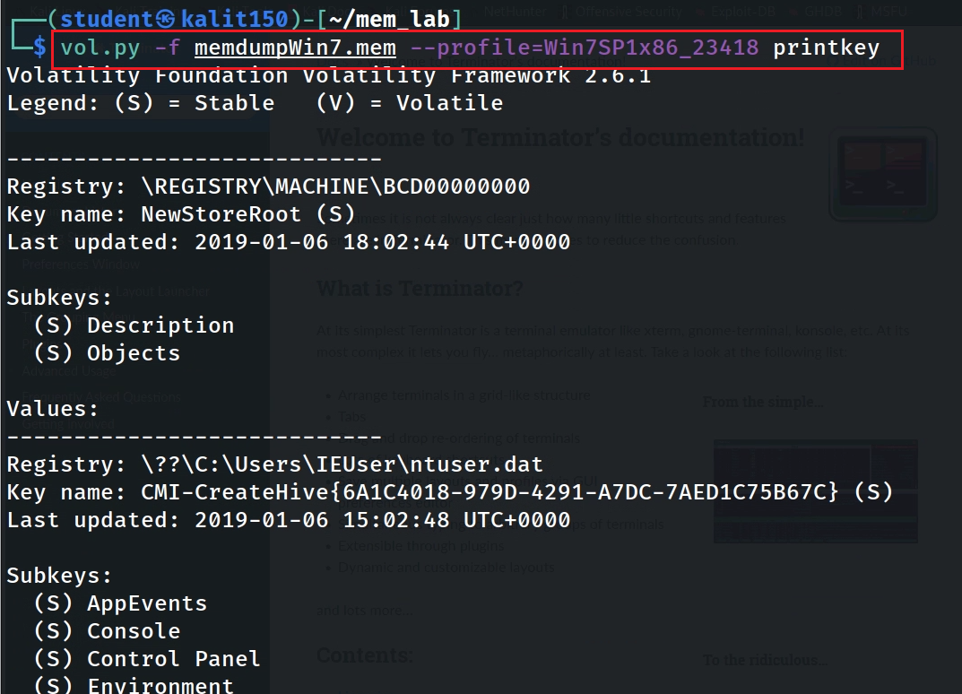
Show all registry keys
Notes:
vol.py -f memdumpWin7.mem --profile=Win7SP1x86_23418 printkey

Slide 16








Investigation
Understand the Suspect and Accounts
Understand the Suspect’s PC
Network Forensics
Investigate Command History
Investigate Suspect’s USB
Investigate Internet Explorer History
Investigate File Explorer History
Timeline Analysis

Slide 17
Understand the Suspect and Accounts

Slide 18
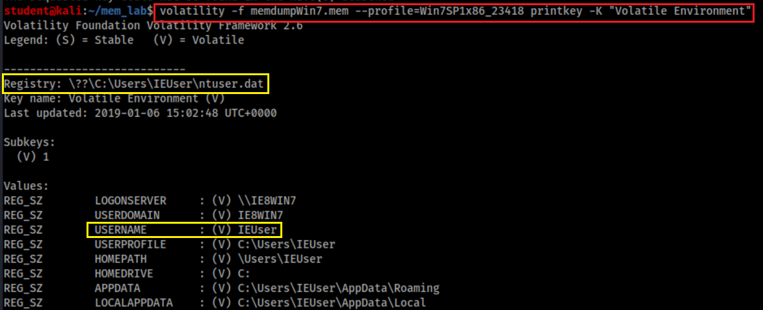
Who was using the device?
Physical file location = {subkeys of active user profile}
=HKEY_USERS \<SID> (linked to by HKEY_CURRENT_USER)
SID: Security Identifier: a unique, immutable identifier of a user, user group, or other security principal.
Users can change names but not SID
Notes:
vol.py -f memdumpWin7.mem --profile=Win7SP1x86_23418 printkey -K "Volatile Environment"

Slide 19
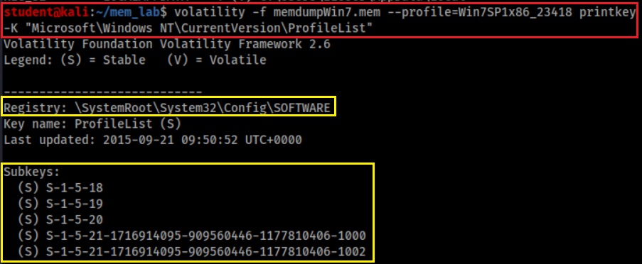
Who are associated with the device?
Sam – HKEY_LOCAL_MACHINE\SAM
Security – HKEY_LOCAL_MACHINE\SECURITY
Software – HKEY_LOCAL_MACHINE\SOFTWARE
System – HKEY_LOCAL_MACHINE\SYSTEM
Default – HKEY_USERS\.DEFAULT
Notes:
volatility -f memdumpWin7.mem --profile=Win7SP1x86_23418 printkey -K "Microsoft\Windows NT\CurrentVersion\ProfileList"

Slide 20
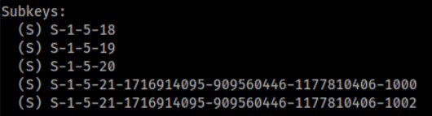
SID format details
S-1-5
S: SID
1: Version 1
5: Managed by the NT security subsystem
SID | Name | Description
S-1-5-18 | Local System | A service account that is used by the operating system.
S-1-5-19 | NT Authority | Local Service
S-1-5-20 | NT Authority | Network Service
S-1-5-21 | Administrator/Guest | A user account for the system administrator.

Slide 21
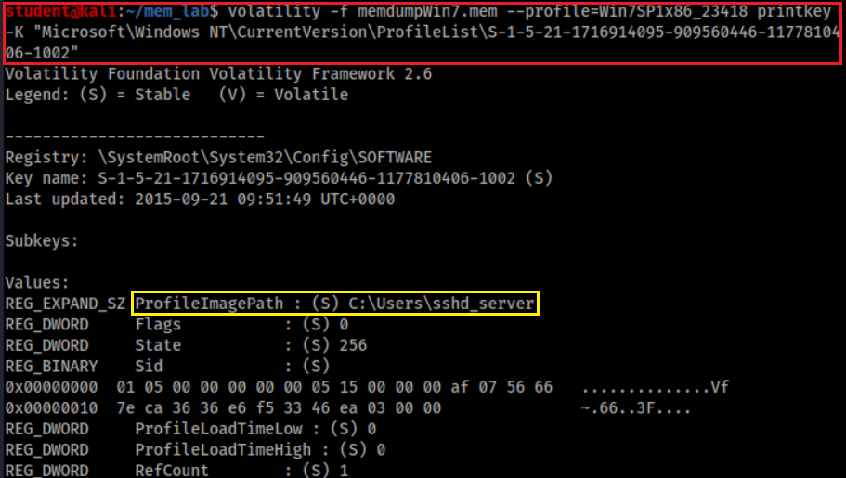
Who has SID= S-1-5-21-1716914095-909560446-1177810406-1002?
SSHD_Server is an account made by an SSH server.., It allows remotely log in to the computer.
Notes:
volatility -f memdumpWin7.mem --profile=Win7SP1x86_23418 printkey -K "Microsoft\Windows NT\CurrentVersion\ProfileList\S-1-5-21-1716914095-909560446-1177810406-1002"

Slide 22
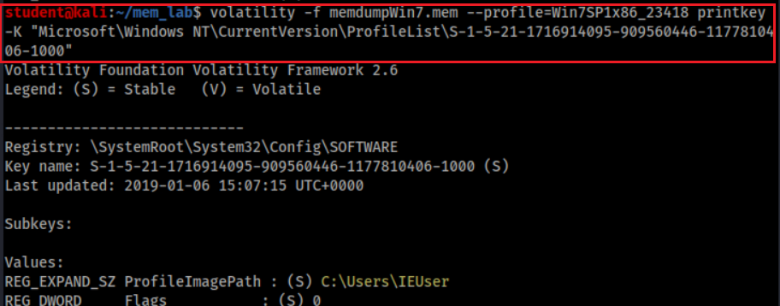
Who has SID= S-1-5-21-1716914095-909560446-1177810406-1000?
Notes:
volatility -f memdumpWin7.mem --profile=Win7SP1x86_23418 printkey -K "Microsoft\Windows NT\CurrentVersion\ProfileList\S-1-5-21-1716914095-909560446-1177810406-1000"

Slide 23
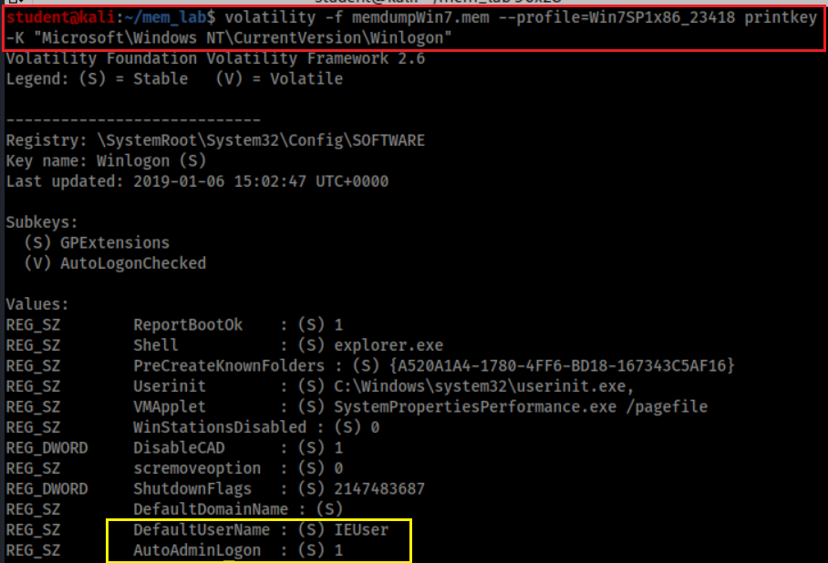
Who is the default logon user?
Default automatically log on

Slide 24
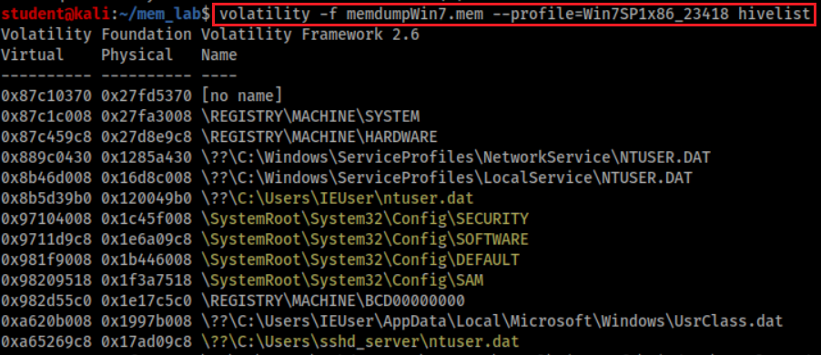
Hive overview
represents pointers to other hives, and is normal
Keys under HKLM\SYSTEM\CurrentControlSet\Control\hivelist
Point to HKEY_LOCAL_MACHINE\SYSTEM
Point to HKEY_LOCAL_MACHINE\HARDWARE
Each user has a profile (ntuser.dat)

Slide 25
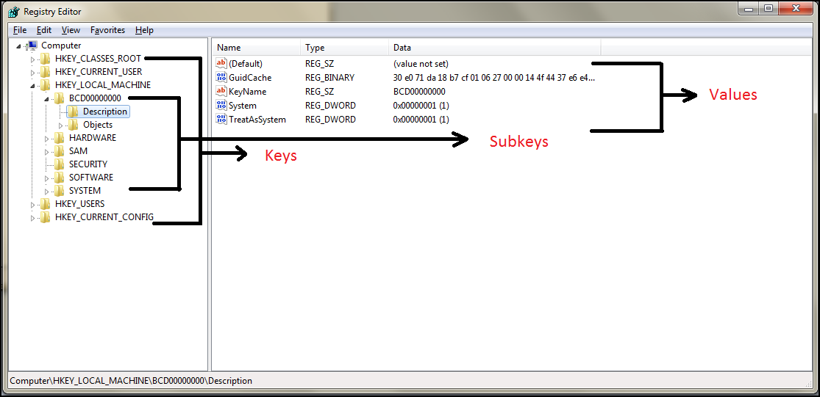
It is the time to review Registry
The five main root keys of registry are:
HKEY_CLASSES_ROOT (HKCR)
HKEY_CURRENT_USER (HKCU)
HKEY_LOCAL_MACHINE (HKLM)
HKEY_USERS (HKU)
HKEY_CURRENT_CONFIG (HKCC)

Slide 26
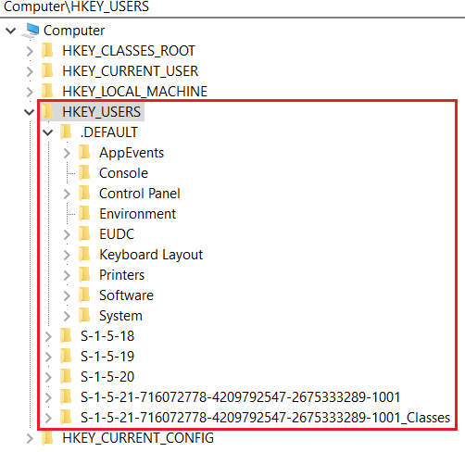
HKEY_USERS (HKU)
Contains information about all the users who logged in to the computer at some point
When log on, the current logged in user profile is linked by HKCU
Saved in each user's profile folder
C:\Users\IEUser\Ntuser.dat
C:\Users\ssh_Server\Ntuser.dat
C:\Users\Default User\Ntuser.dat
contains the base settings for new users when they first logon,

Slide 27
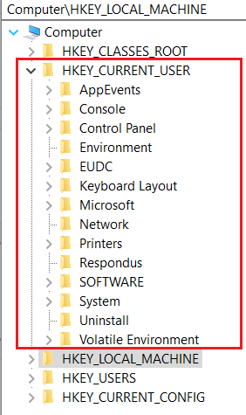
HKEY_CURRENT_USER (HKCU)
Does not contain any data
A link to the subkey of HKEY_USERS
Stores settings for currently logged-in use
Unloaded when the user logs out
If no profile is available, built from default user
Control everything of the current logged user
Environment variables
Desktop settings,
Network connections, printers,
Application preferences.
Keyboard layout
Current logged user information
Treasure for investigators

Slide 28
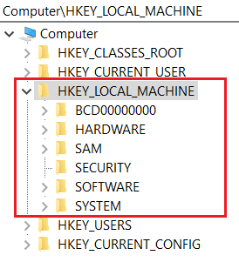
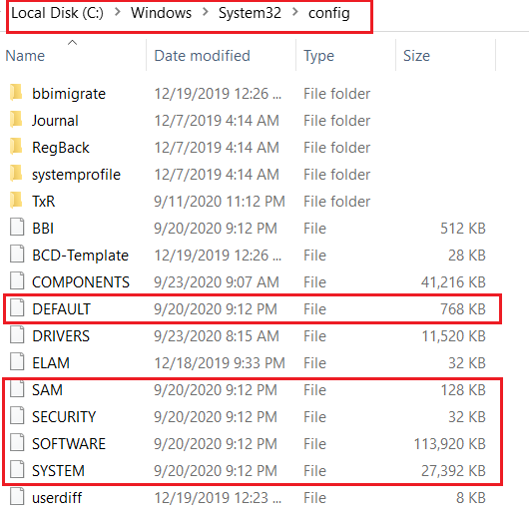
HKEY_LOCAL_MACHINE (HKLM)
Contains computer hardware and software information
Loaded at boot time from
Store Plug-and-Play devices Infor
Created dynamically, not stored in a file
Loaded at boot time from

Slide 29
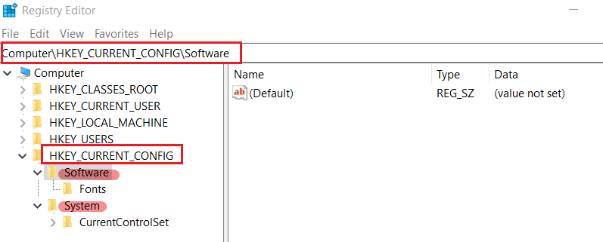
HKEY_CURRENT_CONFIG (HKCC)
It doesn't store any information itself but instead acts as a pointer, or a shortcut, to a registry key
Noting shown here, but points to other registry

Slide 30
Understand the Suspect’s PC

Slide 31
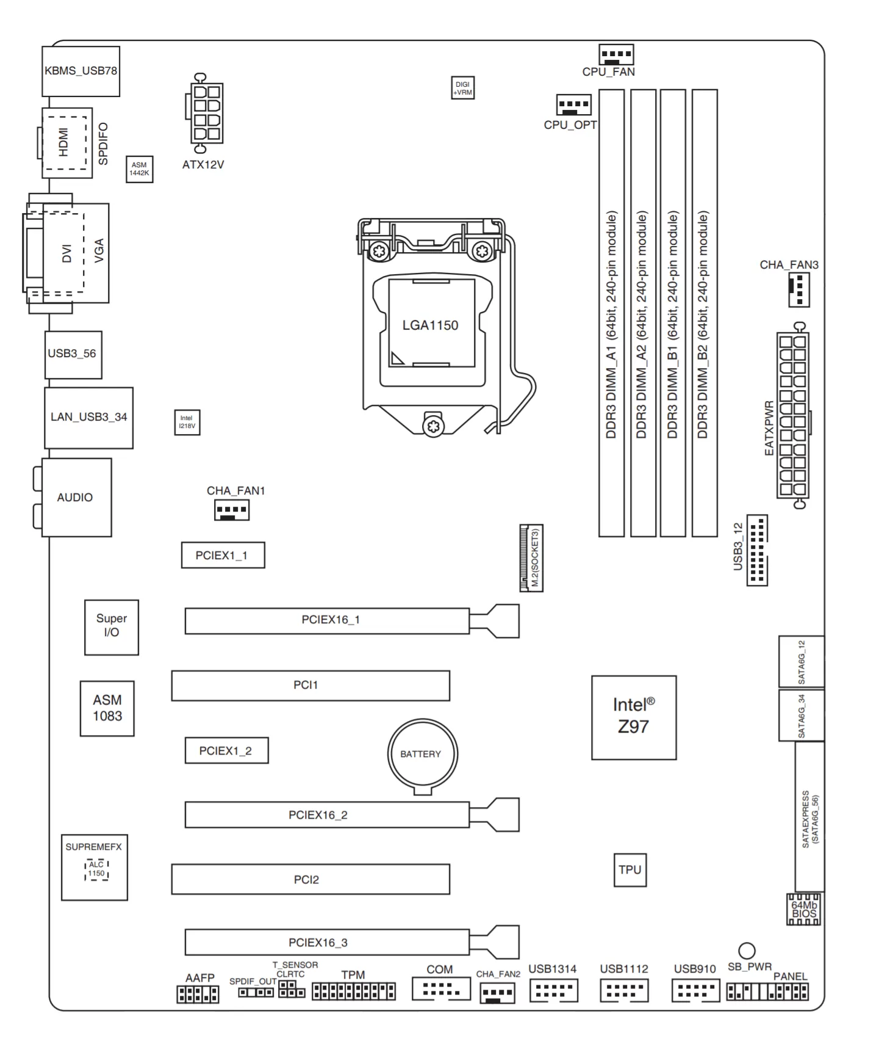
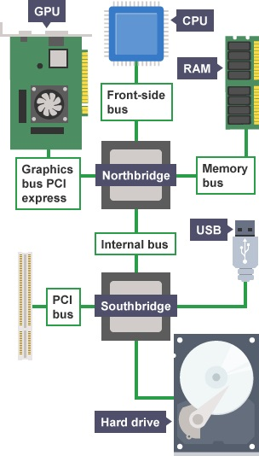
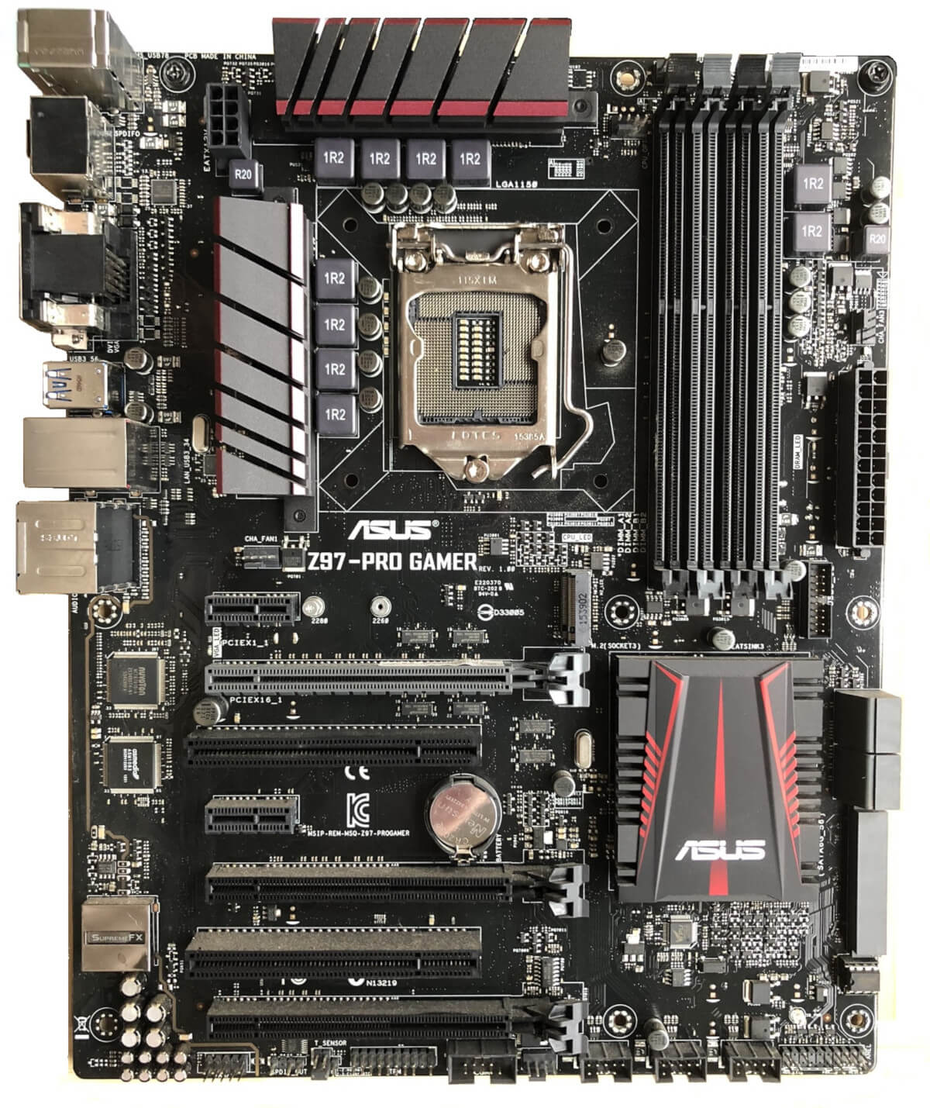
Motherboard layout
Peripheral Component Interconnect
Notes:
https://www.techspot.com/article/1965-anatomy-motherboard/
PCI is a parallel connection, and devices connected to the PCI bus appear to be a bus master to connect directly to its own bus. While PCIe card is a high-speed serial connection. Instead of one bus that handles data from multiple sources, PCIe has a switch that controls several point-to-point serial connections.

Slide 32
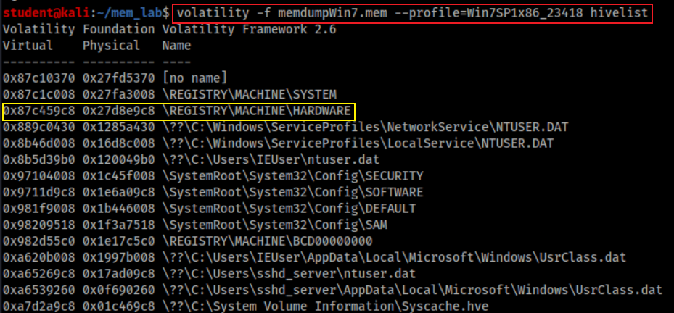
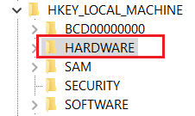
Where to find CPU of the Suspect’s PC?
Find hardware keys
Point to

Slide 33
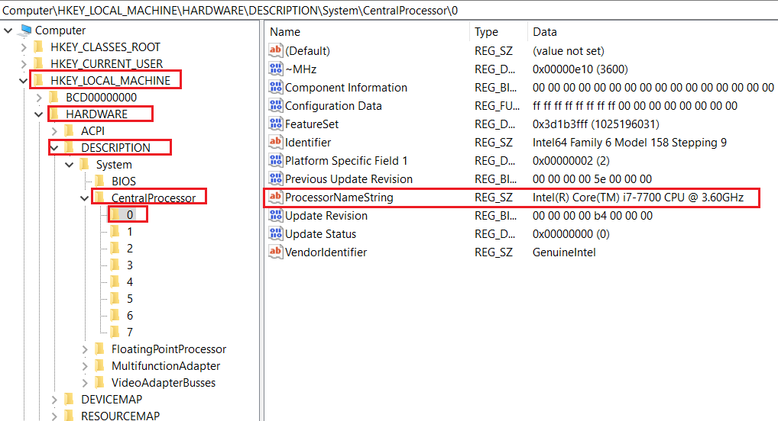
Find key = “DESCRIPTION\CentralProcessor\0”
If your system has multiple processors, they are all listed as subkeys under this key. If your system has only one processor, it is listed as processor 0.

Slide 34
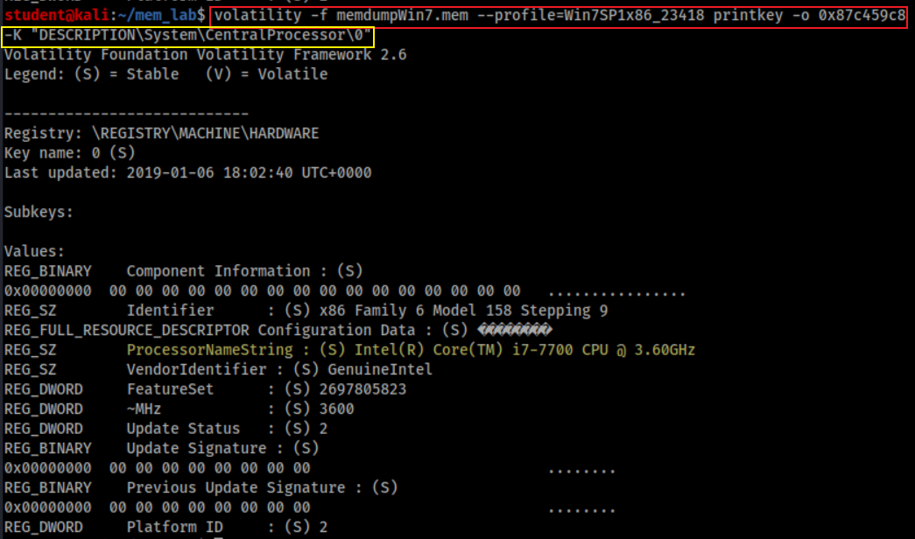
How to find CPU of the Suspect’s PC?
Print key starts from offset 0x87c459c8. Offset can be skipped

Slide 35
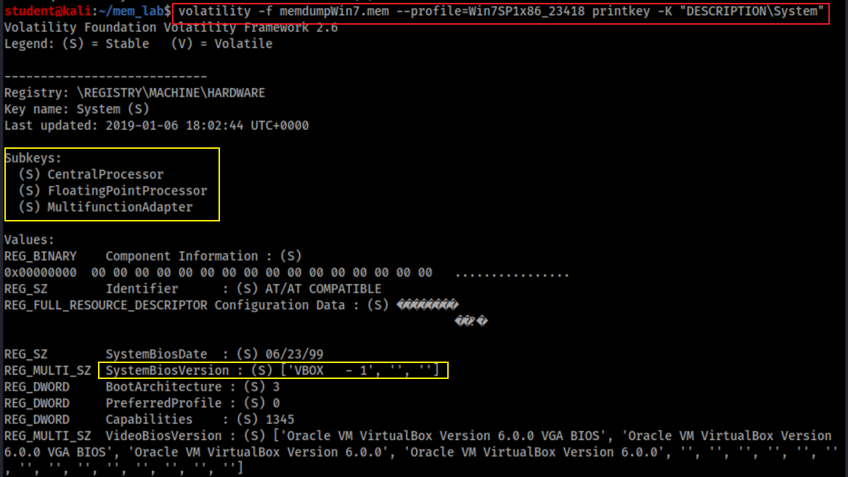
How to find other PC system information?
Show system board, system BIOS, and video BIOS, plus subkeys for the processors and bus controllers

Slide 36
How PC enumerates devices on its bus (data highway)?
A bus driver services a bridge, bus controller, or adapter
A bus driver enumerates the devices on its bus
device's enumerator
Respond to Plug and Play I/O request packets (IRPs)
controls
controls

Slide 37
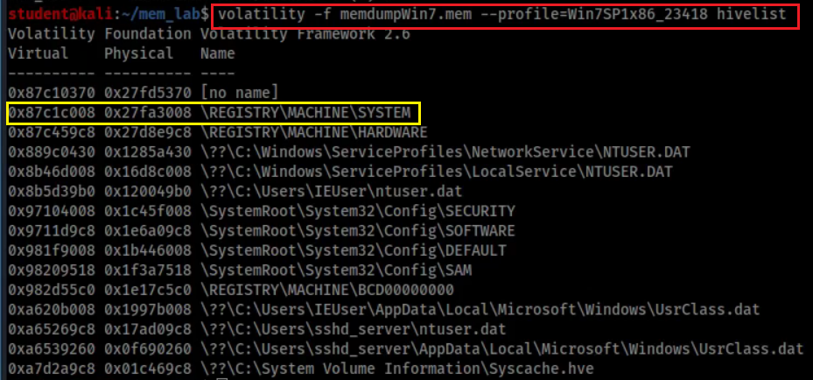
Where the enumerated devices Infor saved?

Slide 38
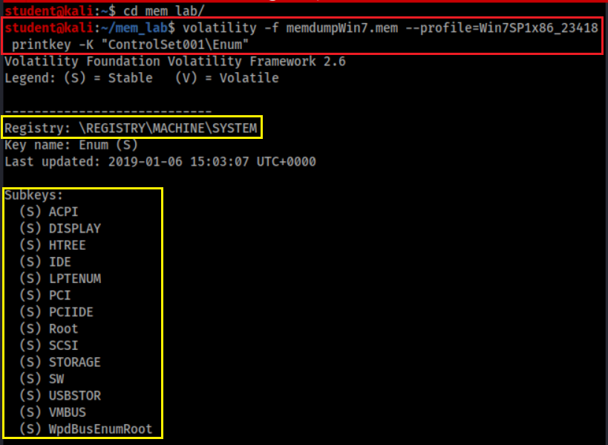
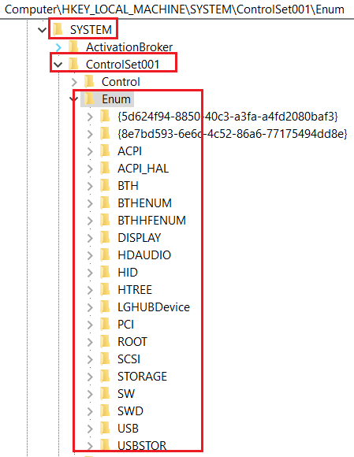
How to enumerated devices?
Enumerate devices

Slide 39
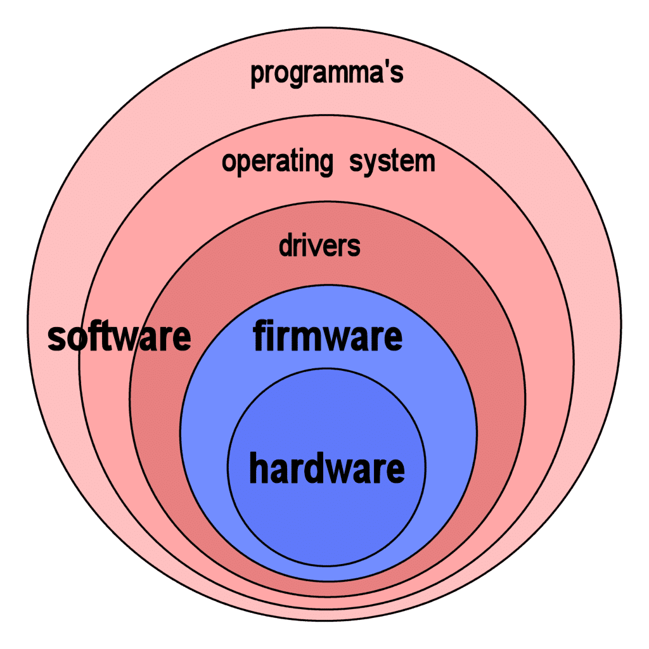
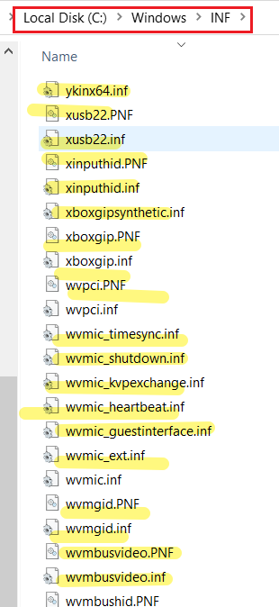
How Windows install device drivers?
Almost all electronic devices contain firmware
When plug-in, device's enumerator (e.g., PnP Bus Drivers)
Reports Device Identification Strings from device firmware
Hardware IDs - vendor-defined
Compatible IDs - vendor-defined
Windows uses Hardware IDs to
locate the information (INF) file that best matches the device
if not, uses compatible IDs
Windows uses INF file to install device drivers

Slide 40
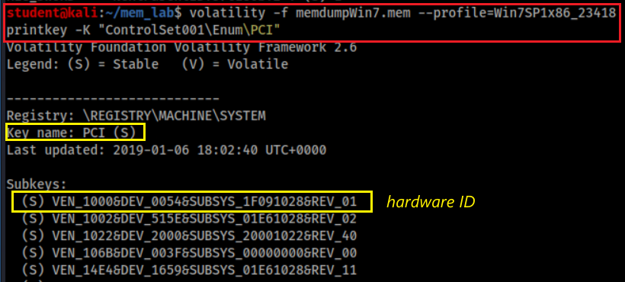
How to find devices connected to PCI?
VEN_XXXX: vendor
DEV_XXXX: model of device
Common VEN_XXXX codes:
Intel – 8086
ATI/AMD – 1002/1022
NVIDIA – 10DE
Broadcom – 14E4
Atheros – 168C
Realtek – 10EC
Creative – 1102
Logitech – 046D

Slide 41
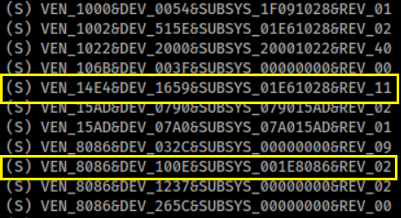
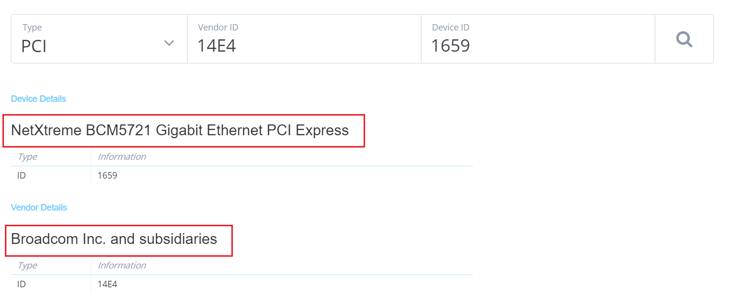
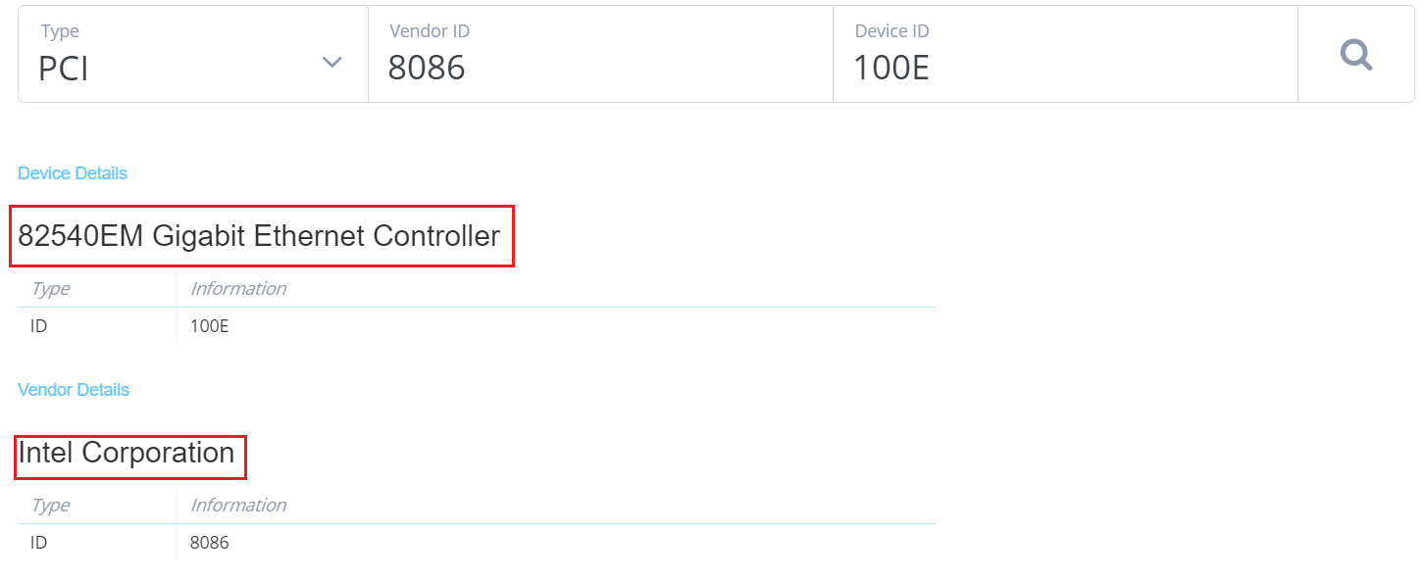
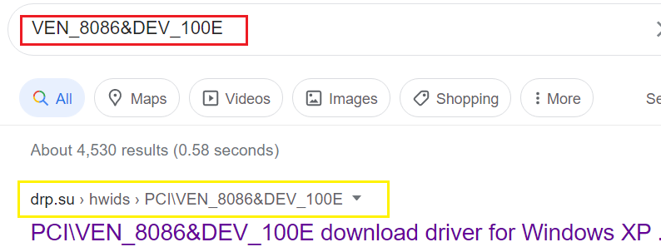
Search device: https://devicehunt.com/
Search driver based on hardware ID

Slide 42
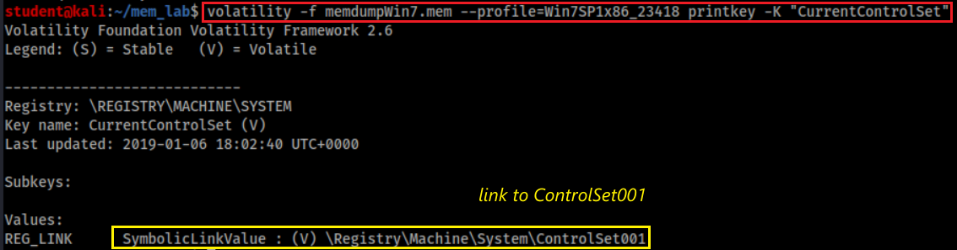
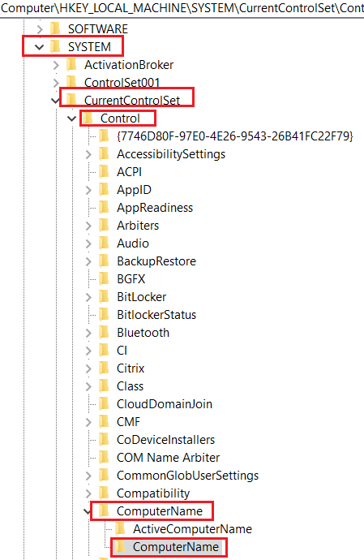
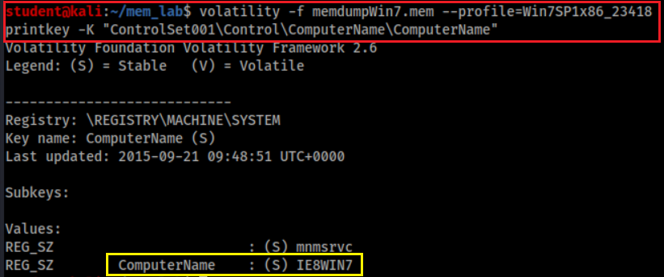
What is the name of suspect’s device?
Note: On a live registry, you will see “CurrentControlSet” instead of “ControlSet001”. Because it is not a live, we need to check ControlSet001
link to
Notes:
volatility -f memdumpWin7.mem --profile=Win7SP1x86_23418 printkey -K "ControlSet001\Control\ComputerName"

Slide 43
Network Forensics

Slide 44

Are there suspicious IPs (processes) connected to the PC?
Scan network objects
grep: only show TCP

Slide 45

Which program that was connected to this suspicious IP address?
Find out process name of 4
Help command
Note: Module Output Options: dot, greptext, html, json, sqlite, text, xlsx

Slide 46

Which program that was connected to this suspicious IP address?
Find out process name of -1 (unidentified process) using the suspicious IP
-Y “192.168.56.5”: Define YARA pattern at IP
--output-file=any file name
YARA is a tool aimed at (but not limited to) helping malware researchers to identify and classify malware samples.

Slide 47

Find the application chrome.exe which PID=2388
The suspect used chrome to download file

Slide 48
Investigate Command History
cmdscan and consoles

Slide 49

Did the suspect use commands to copy files?
Is F drive a USB?

Slide 50

When are these commands executed?
Need to find timestamps because the PID of Command Prompt
Command PID

Slide 51

An alternate method to search command history
Process and PID found

Slide 52

Screen captured

Slide 53
Investigate Suspect’s USB

Slide 54

How a PC recognizes a USB?
USB Mass Storage device Class (MSC) communication protocols
When a USB is plugged in, the Plug and Play (PnP) Manager finds device ID (Hardware IDs or Compatible IDs)
Receives the event => enumerates devices from firmware=> device ID
OS locates the appropriate driver for the device
Queries the device descriptor (.inf) uses Hardware IDs or Compatible IDs
OS loads that driver use .inf
Once the device has been identified
Multiple registry keys will be generated

Slide 55
Generated registry keys can be used as evidence chain
Show a USB was attached to a PC
A USB has an unique Instance ID of each device
The USB has been assigned a drive letter (D, E, F..) of the PC
The drive letter is associated with a suspect’s account
Timestamps need to be verified
Check setupapi.log (if available)

Slide 56
Show a USB was attached to a PC
USB Device interface key is add under
HKEY_LOCAL_MACHINE\SYSTEM\ControlSet001\Control\DeviceClasses
USB Device interface key have a link to
USBSTOR\Disk&Ven_General&Prod_UDisk&Rev_5.00

Slide 57


What is a Device interface GUID?
Each device has an interface with a Globally Unique Identifier (GUID)
To communicate with PC
Organized under DeviceClasses
A device interface subkey is created when a plug and play device driver is successfully loaded.
Disk interface subkey: GUID_DEVINTERFACE_DISK, or DiskClassGUID
Value=53F56307-B6BF-11D0-94F2-00A0C91EFB8B
The subkey will be removed if the device is removed
a hard disk storage (e.g., USB) device interface
Notes:
https://docs.microsoft.com/en-us/windows-hardware/drivers/install/guid-devinterface-disk
https://www.sciencedirect.com/topics/computer-science/removable-storage-device
https://docs.microsoft.com/en-us/previous-versions//ff553412(v=vs.85)?redirectedfrom=MSDN
53F56307-B6BF-11D0-94F2-00A0C91EFB8B

Slide 58

List all device interfaces
Disk interfaces
Notes:
{53f56307-b6bf-11d0-94f2-00a0c91efb8b}

Slide 59

List Disk Interfaces
#USBSTOR
#Disk
&Ven_[VendorName]
&Prod_[ProductName]
&Rev_[RevisionID]
#[UID/SerialNo.]
#{DeviceInterfaceClassID}.
Notes:
volatility -f memdumpWin7.mem --profile=Win7SP1x86_23418 printkey -K "ControlSet001\Control\DeviceClasses\{53f56307-b6bf-11d0-94f2-00a0c91efb8b}"

Slide 60
Other Useful disk interfaces (1)
Tableau connected via Firewire: ##?#SBP2#Tableau&Forensic_SATA_Bridge&LUN0&REV15#000ecc01000f4063#{53f56307-b6bf-11d0-94f2-00a0c91efb8b}
eSATA attached SSD: ##?#IDE#DiskPatriot_Torqx_2_32GB_SSD________________S5FAM014#4&35e86db3&0&0.2.0#{53f56307-b6bf-11d0-94f2-00a0c91efb8b}
F-Response iSCSI disk: ##?#SCSI#Disk&Ven_FRES&Prod_FRES#1&1c121344&0&000000#{53f56307-b6bf-11d0-94f2-00a0c91efb8b}
External non generic USB Disk: \##?#USBSTOR#Disk&Ven_FUJITSU&Prod_MHT2060AH&Rev_#43527242060A&0#{53f56307-b6bf-11d0-94f2-00a0c91efb8b}
External generic USB Disk: ##?#USBSTOR#Disk&Ven_&Prod_&Rev_PMAP#07032AE8AFBE2481&0#{53f56307-b6bf-11d0-94f2-00a0c91efb8b}
Notes:
https://www.hecfblog.com/2013/08/daily-blog-67-understanding-artifacts.html

Slide 61
Other Useful disk interfaces (2)
USB attached android phone: ##?#USBSTOR#Disk&Ven_Android&Prod___UMS_Composite&Rev___00#8&d3cc3f0&0&304D1905736FB98E&0#{53f56307-b6bf-11d0-94f2-00a0c91efb8b}
Volume GUIDs: SYSTEM\\Control\DeviceClasses\{53F5630D-B6BF-11D0-94F2-00A0C91EFB8B}
MagicISO mounted image: ##?#SCSI#CdRom&Ven_MagicISO&Prod_Virtual_DVD-ROM&Rev_1.0A#1&2afd7d61&0&0000#{53f5630d-b6bf-11d0-94f2-00a0c91efb8b}
Volume of the generic USB storage device: ##?#STORAGE#VOLUME#_??_USBSTOR#DISK&VEN_&PROD_&REV_PMAP#07032AE8AFBE2481&0#{53F56307-B6BF-11D0-94F2-00A0C91EFB8B}#{53f5630d-b6bf-11d0-94f2-00a0c91efb8b}

Slide 62

Access DeviceClass\Disk Interface\USB Interface
Notes:
volatility -f memdumpWin7.mem --profile=Win7SP1x86_23418 printkey -K "ControlSet001\Control\DeviceClasses\{53f56307-b6bf-11d0-94f2-00a0c91efb8b}\##?#USBSTOR#Disk&Ven_General&Prod_UDisk&Rev_5.00#6&1bec0f48&0&_&0#{53f56307-b6bf-11d0-94f2-00a0c91efb8b}"

Slide 63

Access DeviceClass\Disk Interface\USB Interface\# SymbolicLink
USB plug-in timestamp
It is a symbolic link, we can check and verify the subkey
Notes:
volatility -f memdumpWin7.mem --profile=Win7SP1x86_23418 printkey -K "ControlSet001\Control\DeviceClasses\{53f56307-b6bf-11d0-94f2-00a0c91efb8b}\##?#USBSTOR#Disk&Ven_General&Prod_UDisk&Rev_5.00#6&1bec0f48&0&_&0#{53f56307-b6bf-11d0-94f2-00a0c91efb8b}\#"

Slide 64


Verify USBTOR subkey and timestamp
USB Storage
Same timestamp
Ven_ [vendor name]
Prod_[product name assigned by vendor]
Rev_[revision ID]
Can we find Vendor ID and Product ID?
Notes:
volatility -f memdumpWin7.mem --profile=Win7SP1x86_23418 printkey -K "ControlSet001\Enum\USBSTOR"

Slide 65
How to find Vendor ID and Product ID?
When a USB device is connected to a Windows PC, Windows will remember its vendor and class IDs to reference the next time it is plugged in. This information is stored in:
HKEY_LOCAL_MACHINE\SYSTEM\CurrentControlSet\Enum\USB
E.g., Vid_0c55&Pid_5416
Can search device information
https://www.the-sz.com/products/usbid/
Note: Registry dumped from memory doesn’t have VID and PID
Normal registry will contain these information

Slide 66

What is the Instance ID of USB?
A device identification string that distinguishes a device from other devices of the same type on a computer.
the second character is &, means
the USB doesn’t provide SN
UID is created by PnP, is only unique system wide
Notes:
volatility -f memdumpWin7.mem --profile=Win7SP1x86_23418 printkey -K "ControlSet001\Enum\USBSTOR\Disk&Ven_General&Prod_UDisk&Rev_5.00“
Although a unique serial number is required for devices that manufacturers want to qualify for the Windows Logo program (www.microsoft.com/whdc/archive/usbfaq.mspx#ERCAC), not all devices include a serial number. For devices that do not have a serial number, the PnP Manager will create a unique instance ID for that device(6&1bec0f48&0&_&0)

Slide 67


What is the friendly name of the USB?
Note: It is hardware, difference from Disk interface GUID, which is software
Notes:
volatility -f memdumpWin7.mem --profile=Win7SP1x86_23418 printkey -K "ControlSet001\Enum\USBSTOR\Disk&Ven_General&Prod_UDisk&Rev_5.00\6&1bec0f48&0&_&0“
ClassGuid = {4d36e967-e325-11ce-bfc1-08002be10318}
https://docs.microsoft.com/en-us/windows-hardware/drivers/install/system-defined-device-setup-classes-reserved-for-system-use

Slide 68


What is ContainerID?
A system-supplied device identification string
Groups the functional devices associated with a single-function or multifunction device installed in the computer.
Introduced in Windows 7
the Plug and Play (PnP) manager uses the container ID to group one or more device
All physical devices should be assigned a ContainerID – not just storage devices.
monitors, external speakers, keyboards

Slide 69



Which drive letter does the USB was assigned to?
Notes:
volatility -f memdumpWin7.mem --profile=Win7SP1x86_23418 printkey -K "MountedDevices"

Slide 70
Problem of only exam /System/MountedDevices
The registry key may not have a correct drive letter.
Windows only tracks the last device that has been assigned a particular drive letter (D, E, F, etc.)
We need to exam NTUSER.DAT
Next slide

Slide 71


Who did mount F volume to PC?
Notes:
volatility -f memdumpWin7.mem --profile=Win7SP1x86_23418 printkey -K "Software\Microsoft\Windows\CurrentVersion\Explorer\MountPoints2"

Slide 72

When the USB Last Attached to PC?
Notes:
volatility -f memdumpWin7.mem --profile=Win7SP1x86_23418 printkey -K "Software\Microsoft\Windows\CurrentVersion\Explorer\MountPoints2\F"

Slide 73
USB Evidence Source List
SYSTEM/CurrentControlSet/Enum/USBSTOR
Referened by SYSTEM\ControlSet001\Control\DeviceClasses\{53f56307-b6bf-11d0-94f2-00a0c91efb8b}\UID\
SYSTEM/MountedDevices
Drive letter or volume mounted
NTUSER.DAT/Software/Microsoft/Windows/CurrentVersion/Explorer/MountPoints2
eveal which user was logged in and active
SYSTEM/CurrentControlSet/Enum/USB
Not available in memory dump
(optional) Windows Vista+ – ROOT/Windows/inf/setupapi.dev.log
(optional) Windows XP – ROOT/Windows/setupapi.log

Slide 74
Investigate Internet History

Slide 75

Did the suspect use Internet Explore?
IE history/cache
Control X: exit
Notes:
vol.py -f memdumpWin7.mem --profile=Win7SP1x86_23418 iehistory

Slide 76
Are there any activates in 2019? No
Notes:
volatility -f memdumpWin7.mem --profile=Win7SP1x86_23418 iehistory | grep 2019

Slide 77
Investigate File Explorer History
Shellbags

Slide 78
What are Shellbags?
Registry keys to track a folder window when viewed through File Explorer;
views, sizes and positions
includes network folders and removable devices
available since Windows XP
Giving the investigator great insight into
the folder
browsing history of a suspect
details for any folder that might no longer exist on a system
due to deletion, or being located on a removable device
Note: shellbags only get created when accessing the folders
copying, moving, deleted, etc. will not change anything.
Notes:
https://www.magnetforensics.com/blog/forensic-analysis-of-windows-shellbags/

Slide 79

What are registry keys that shellbags are structured from?
Structured from two main registry keys
BagMRU: stores folder names and records folder paths by creating the similar tree structure.
Bags: stores the view preferences such as the window size, location and view mode
Physical location (Win7 +)
%UserProfile%\NTUSER.dat
%UserProfile%\AppData\Local\Microsoft\Windows\UsrClass.dat.

Slide 80

How shellbags are structured?
Structured In hierarchy to which they are accessed through Windows Explorer
each numbered folder representing a parent or child folder of the one previous.
Notes:
https://www.sans.org/reading-room/whitepapers/forensics/windows-shellbag-forensics-in-depth-34545

Slide 81

Are there any folder access activities on 2019-01-06?
Interesting! we need to look into it.
Notes:
volatility -f memdumpWin7.mem --profile=Win7SP1x86_23418 shellbags | grep "Last updated: 2019-01-06" | sort
Last updated: 2019-01-06 14:32:21 UTC+0000
Last updated: 2019-01-06 14:32:53 UTC+0000
Last updated: 2019-01-06 14:55:45 UTC+0000
Last updated: 2019-01-06 15:04:40 UTC+0000
Last updated: 2019-01-06 15:04:40 UTC+0000
Last updated: 2019-01-06 15:04:40 UTC+0000
Last updated: 2019-01-06 15:07:03 UTC+0000

Slide 82


What are folder access activities on 2019-01-06?
Print shellbags to a file shellbags.html
Easy to review html files
Verify shellbags.html has be generated

Slide 83

A suspect accesses the download folder (twice).
First Access folder
Last Access of folder or last preference change, not the time of changing the files in the folder
Notes:
https://www.sans.org/blog/computer-forensic-artifacts-windows-7-shellbags/

Slide 84
Timeline Analysis

Slide 85

Chrome.exe downloads
2019-01-04 16:05:12 GMT
First review download folder
2019-01-06 14:49:40 UTC
USB plugged in
2019-01-06 15:02:54 UTC

Slide 86
USB assigned to F volume
2019-01-06 15:03:06 UTC
Last review download folder: 2019-01-06 15:04:40 UTC
Command Prompt with Copy command:
2019-01-06 15:06:011 UTC

Slide 87
Chrome.exe downloads:
2019-01-04 16:05:12
First review download folder
: 2019-01-06 14:49:40 UTC
USB plugged in: 2019-01-06 15:02:54 UTC
USB assigned to F volume: 2019-01-06 15:03:06 UTC
Command Prompt with Copy command
: 2019-01-06 15:06:11 UTC
Last review download folder
: 2019-01-06 15:04:40 UTC

Slide 88
Note
When a folder is deleted, the correspondent ShellBag registry keys and values will not be removed.
However, several tools have been developed to remove the ShellBag information from the registry.

Slide 89
Post-Investigation

Slide 90
What is Windows 7 password?
Dump password hashes from memory
Using John the Ripper to crack password
John the Ripper is a free password cracking software tool.
password.lst is the default password dictionary

Slide 91


Dump NTLM hash
The password to your VM IEUser is "Passw0rd!"
Save IEUser’s password hash to a file
Notes:
Administrator:500:aad3b435b51404eeaad3b435b51404ee:fc525c9683e8fe067095ba2ddc971889:::
Guest:501:aad3b435b51404eeaad3b435b51404ee:31d6cfe0d16ae931b73c59d7e0c089c0:::
IEUser:1000:aad3b435b51404eeaad3b435b51404ee:fc525c9683e8fe067095ba2ddc971889:::
sshd:1001:aad3b435b51404eeaad3b435b51404ee:31d6cfe0d16ae931b73c59d7e0c089c0:::
sshd_server:1002:aad3b435b51404eeaad3b435b51404ee:8d0a16cfc061c3359db455d00ec27035:::

Slide 92


Find the location of John’s default password.lst
/: root f: file
Search passwords contain the string “pass” ignore case
i: ignore case

Slide 93

You can add a new password string “Passw0rd!” to the dictionary
Need root privilege
Verify the password string “Passw0rd!” has been added to the dictionary

Slide 94

Find IEUser’s password

Slide 95
Try Other Plugins

Slide 96


How to download plugins
Clone a plugin repo
Show downloaded plugins
Notes:
https://github.com/cube0x8/chrome_ragamuffin.git

Slide 97

How to find chrome history?
Plugins may not work!

Slide 98
References
https://www.forwarddefense.com/pdfs/Memory-Analysis-with-Volatility.pdf
https://www.andreafortuna.org/2017/07/31/volatility-my-own-cheatsheet-part-6-windows-registry/
http://www.mrtweaks.com/regedit.htm
https://tweaklibrary.com/what-are-registry-root-keys/
https://docs.microsoft.com/en-us/windows-hardware/drivers/usbcon/usb-device-specific-registry-settings
https://docs.microsoft.com/en-us/windows-hardware/drivers/install/standard-usb-identifiers
https://www.forensicfocus.com/forums/general/usbstor-registry-entries-windows-7/
https://docs.microsoft.com/en-us/windows-hardware/drivers/install/instance-ids
http://techexe.net/computer-fundamentals/
https://docs.microsoft.com/en-us/windows-hardware/drivers/install/device-identification-strings
https://kuscholarworks.ku.edu/bitstream/handle/1808/19390/Kang_ku_0099M_14318_DATA_1.pdf;jsessionid=8069E32208405DF2EC49129DDE02DF4D?sequence=1
http://what-when-how.com/windows-forensic-analysis/registry-analysis-windows-forensic-analysis-part-5/

